Slide 1
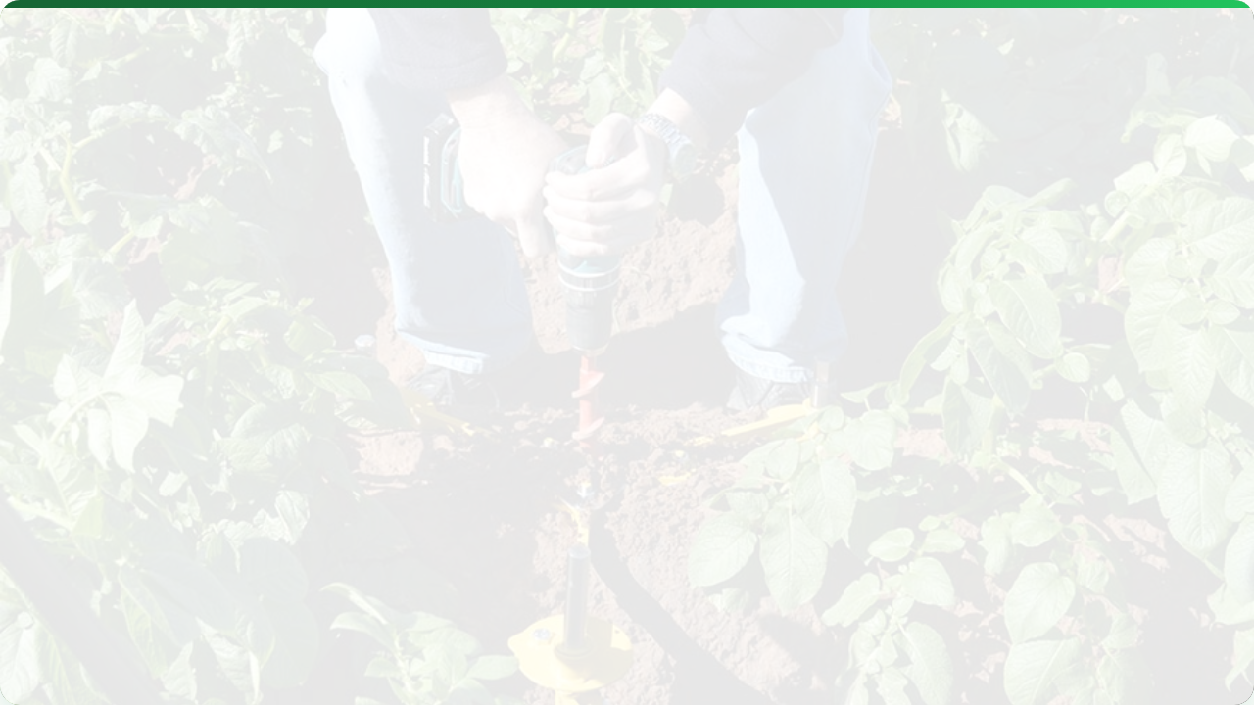



PROXIMAL SOIL SENSORS
Lecture 4: Moisture, Temperature & EC
AGE 418
Dr. Kadeghe Fue

Slide 2




Lecture Roadmap
Soil Moisture
Temperature
Conductivity (EC)
TDR, FDR, Tensiometers
Thermocouples, Thermistors
Veris (Contact), EM38 (Induction)

Slide 3
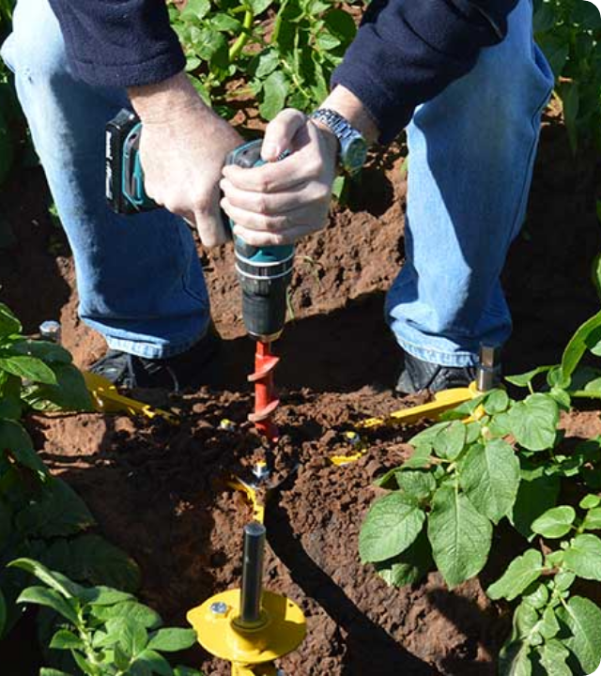
Proximal Sensing
Definition: Sensors that operate in direct contact with the soil or within close proximity (less than 2 meters).
Unlike Remote Sensing (Satellites), these sensors provide high-resolution, specific data about the soil profile.

Slide 4

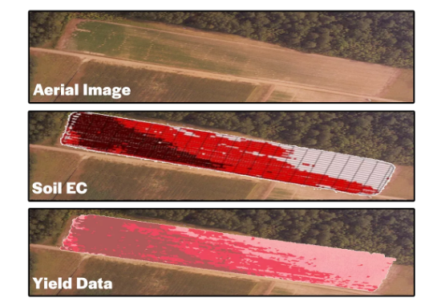
Why Measure Soil?
The "Black Box"
Soil properties vary significantly across a single field due to:
Topography (Hills vs Valleys)
Historical Management
Parent Material
Goal: Move from "Field Average" to "Site Specific".

Slide 5


Soil Moisture Sensing
Water is the most limiting factor in Tanzanian agriculture. Accurate measurement determines When and How Much to irrigate.
Gravimetric
Volumetric
Weighing wet vs dry soil.
(Accurate but Slow)
Using sensors (TDR/FDR).
(Instant & Continuous)

Slide 6
The Physics: Dielectric Constant ($K_a$)
Most sensors measure the soil's ability to store an electrical charge.
Material | Dielectric Constant ($K_a$)
Air | 1
Dry Soil | 3 - 5
Water | 80
Since water has such a high $K_a$, any change in the soil's $K_a$ is directly related to water content.

Slide 7

Time Domain Reflectometry (TDR)
Principle: Measures the travel time of an electromagnetic pulse along a metal waveguide (probe).
More Water = Higher $K_a$ = Slower Pulse = Longer Travel Time.

Slide 8
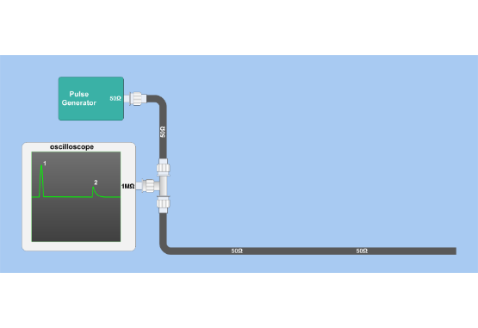
TDR Visualization
Probes: Usually 2 or 3 steel rods.
Accuracy: Very high (+/- 1%).
Benefit: Independent of soil texture/salinity.
Cost: Expensive ($$$).

Slide 9
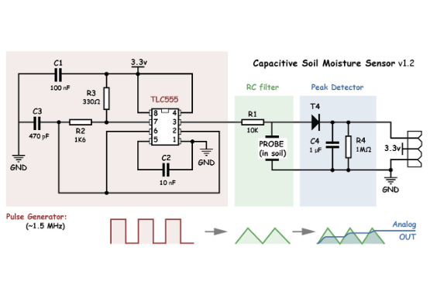
Frequency Domain (FDR)
Capacitance Probes
Uses the soil as part of a capacitor circuit.
Mechanism: Measures the change in oscillating frequency caused by soil moisture.
Design: Often plastic tubes with sensor rings at different depths.
Pros: Cheaper, fast response.
Cons: Needs careful calibration for clay soils.

Slide 10
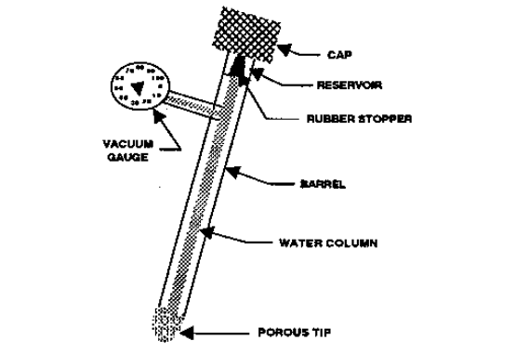
Tensiometers
Measures Tension, not Content.
It tells you how hard the plant roots have to pull to get water.
Structure: Porous ceramic cup + water filled tube + vacuum gauge.
Physics: Dry soil pulls water out of the cup, creating a vacuum.
Unit: Centibars or kPa.

Slide 11
Sensor Comparison
Type | Measures | Accuracy | Cost
TDR | Volumetric Content | High | $$$
FDR (Capacitance) | Volumetric Content | Medium | $$
Tensiometer | Soil Water Tension | High (Wet Soils) | $

Slide 12
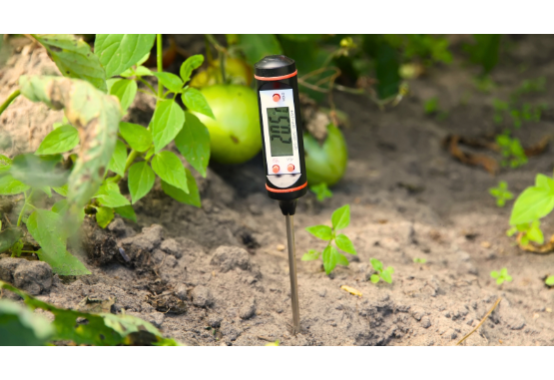
Soil Temperature
Temperature controls biological rates.
Germination: Seeds need specific temp thresholds (e.g., Maize > 10°C).
Microbial Activity: Nitrogen mineralization slows in cold soil.
Root Growth: Inhibited by extreme heat or cold.

Slide 13

Temp Sensor Types
Thermocouples
Thermistors
Infrared (IR)
Two dissimilar metals joined together. Generates voltage based on heat difference. Rugged and cheap.
Resistor that changes resistance with temperature. More accurate but fragile.
Non-contact. Measures surface temperature only.

Slide 14

Electrical Conductivity (EC)
Definition: The ability of the soil to conduct an electrical current.
EC is a "surrogate" measurement. It doesn't tell us exactly what is there, but it correlates strongly with physical properties.

Slide 15




What Influences EC?
Soil Texture
Salinity
Moisture
Clay conducts better than Sand (holds more water/ions).
Salt ions conduct electricity. High EC often means Salinity.
Dry soil is an insulator. Wet soil is a conductor.

Slide 16
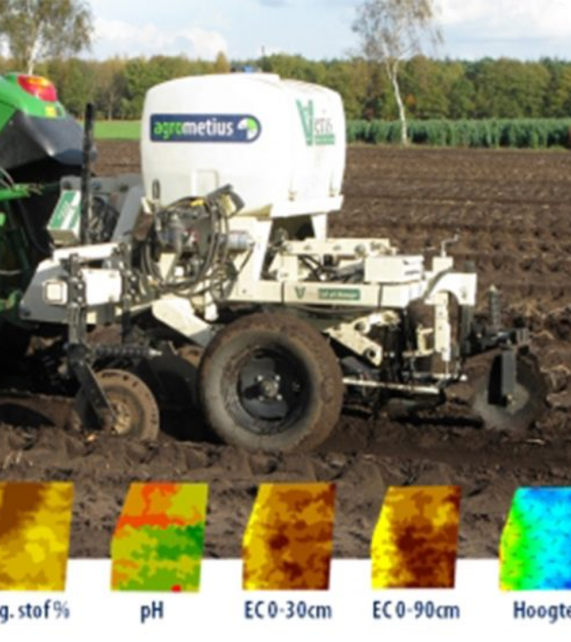
Contact Sensors: Veris
Mechanism: Uses coulters (discs) that cut into the soil.
One pair injects current.
Other pairs measure voltage drop.
Pro: Direct measurement, not affected by surface residue.
Con: Requires contact (slower, abrasive).

Slide 17
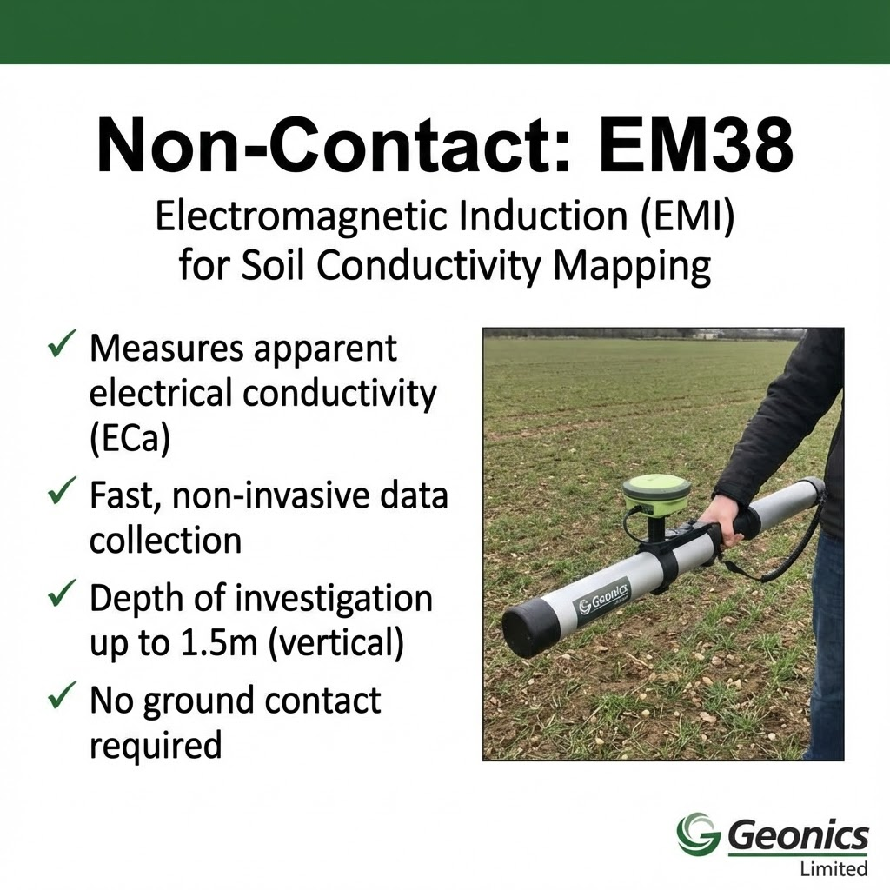
Non-Contact: EM38
Electromagnetic Induction (EMI)
Transmitter coil creates a magnetic field.
Induces currents in the soil.
Receiver coil measures the secondary field.
Pro: Fast, non-invasive (can pull behind ATV).
Con: Sensitive to metal nearby.

Slide 18
Creating Management Zones
We use EC data to zone the field.
High EC Zone: Likely Clay or Saline. Holds water well.
Low EC Zone: Likely Sand. Drains fast.
Action: Sample these zones separately to confirm.

Slide 19
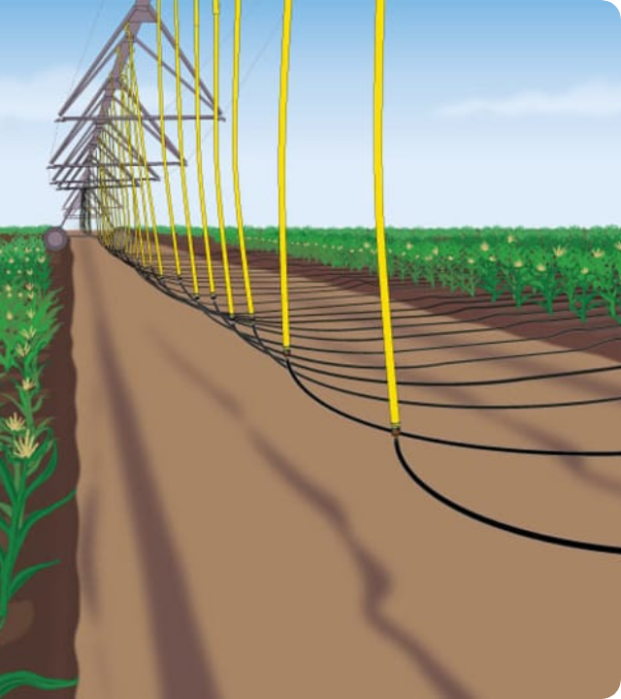
App: Precision Irrigation
Goal: Zero stress, Zero waste.
By placing capacitance probes in the root zone, we can automate drip irrigation to turn on only when the Tensiometer reads > 30 kPa.
Result: 40% Water Savings.

Slide 20


App: Variable Rate Seeding
Sandy Zones (Low EC)
Clay Zones (High EC)
Low Water Holding Capacity.
High Water/Nutrient Holding.
Action: Lower Seed Population (Don't compete for limited water).
Action: Higher Seed Population (Maximize Yield).

Slide 21
Lecture Summary
Moisture
EC
Application
TDR and FDR sensors measure dielectric constant ($K_a$) for instant volumetric readings.
Electrical Conductivity (Veris/EM38) maps soil texture and salinity variability.
Data drives precision irrigation and Variable Rate seeding zones.
Next Class: Lecture 5 - Proximal Nutrient Sensors (N, P, K)

Slide 22

Questions?
Dr. Kadeghe Fue | AGE 418
Sokoine University of Agriculture

